Slide 1
60 MW Solar Power Plant & 115 KV 34.5 KV Substation Design Project
EE 491 | Fall 2019 | sdmay20-14
Jake Ciccola, Ethan Curnutte, Blake Danek,
Michael Lortz, Ada Lupa, Bashir Mohamed
Advisor: Dr. Ajjarapu
Client: Black & Veatch
http://sdmay20-14.sd.ece.iastate.edu/
Notes:
ethan

Slide 2
Project Plan
EE 491 | Fall 2019 | sdmay20-14
Problem Statement | Market survey
Solution | Potential Risks & Mitigation
Functional Requirements | Cost Estimate
Non-functional Requirements | Project Milestones & Schedule
Technical Constraints
Notes:
ethan

Slide 3
Problem
We need to create an energy supply big enough to power a small town
Looking to reduce carbon footprint by switching to a renewable resource and eliminating fossil fuels
sdmay20-14 | 1
Notes:
Bashir
image: http://web.mit.edu/12.000/www/m2015/2015/climatechange.html

Slide 4
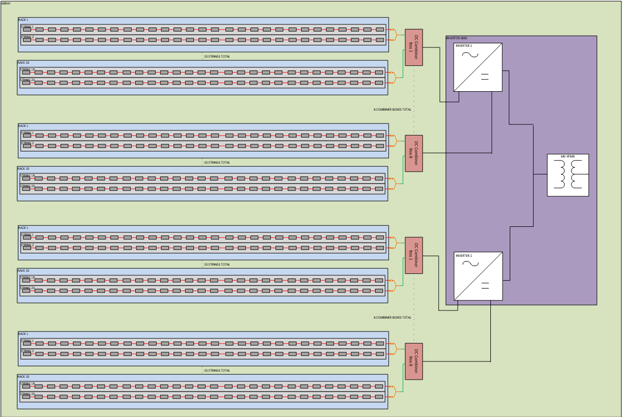
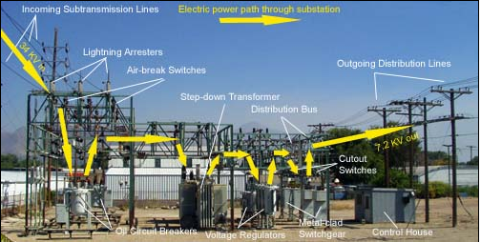
Solution
First semester: Create solar power plant
Second Semester:115 kV/34.5 kV Design the substation, which connects the solar farm to the grid.
sdmay20-14 | 2
Notes:
Bashir

Slide 5
Functional Requirements
Solar Farm Variables
Fixed Rack System
Panel: JA Solar 380W Double Glass Module
Combiner Box: Disconnect Combiner
Inverter: ABB 3 MW Central Inverter
Inverter Loading Ratio (ILR): 1.29
Substation Variables
One-line diagrams
Substation ground grid layout
Protection and controls schematics
sdmay20-14 | 3
Notes:
Ethan

Slide 6
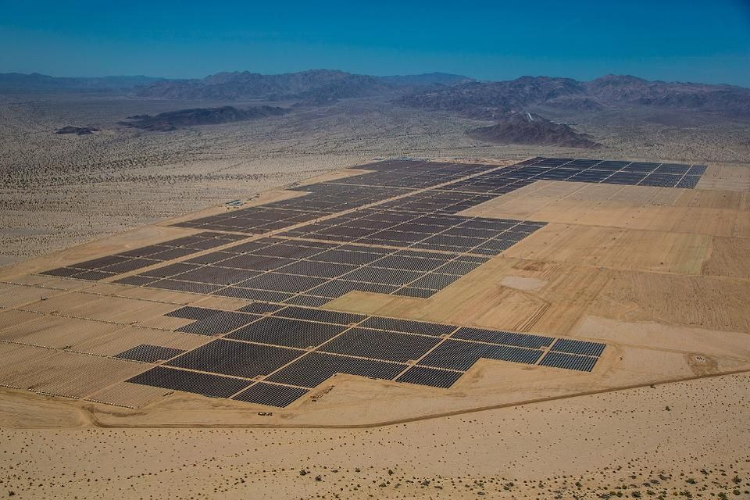
Non-Functional Requirements
Location: Albuquerque, NM
High irradiance, mild weather, low land cost
IEEE requirements
Ethics
NEC requirements
Wire sizes
Wire material
Schedule
Budget
Weekly status reports
Weekly safety moments
sdmay20-14 | 4
Notes:
Ethan
Image: https://www.forbes.com/sites/gauravsharma/2019/01/17/solar-power-outperforming-wind-as-renewable-energy-becomes-commonplace/#61b8c4dc6ea0

Slide 7
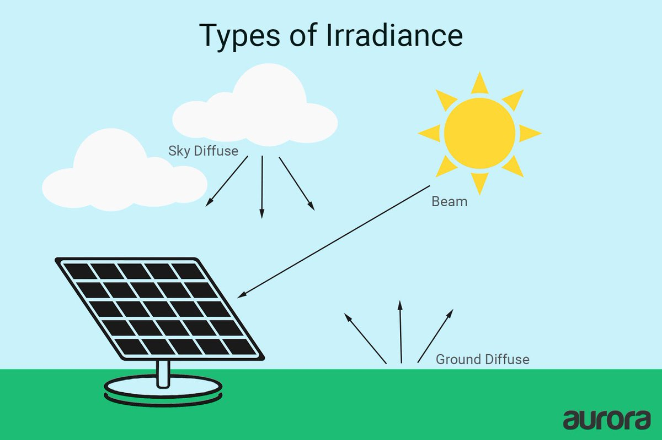
Technical Constraints
Difficulties associated with B&V materials
Learning curve with complex spreadsheets
Being able to read and find necessary information from datasheets
Challenges associated with location identification
sdmay20-14 | 5
Notes:
Jake
image: https://www.aurorasolar.com/?utm_term=aurora%20solar&utm_campaign=Brand+Keywords&utm_source=adwords&utm_medium=ppc&hsa_tgt=kwd-323947520554&hsa_grp=41615292461&hsa_src=g&hsa_net=adwords&hsa_mt=e&hsa_ver=3&hsa_ad=328387062904&hsa_acc=5794356793&hsa_kw=aurora%20solar&hsa_cam=898431090&gclid=EAIaIQobChMI5OO8k_Gp5gIVC8RkCh3GpwekEAAYASAAEgKeOfD_BwE

Slide 8
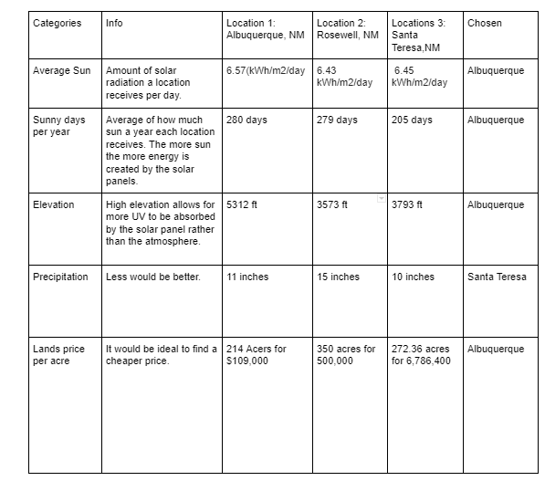
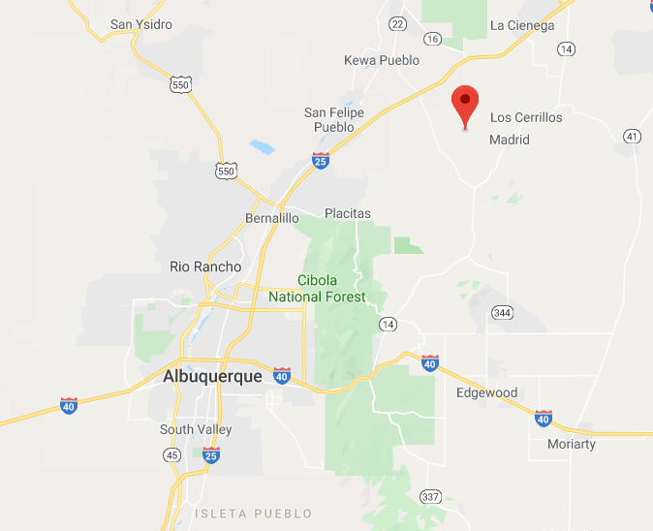
Market Survey
Chosen location:
In Albuquerque, NM area; specifically Cerrillos, Santa Fe Country.
Approximately 214 acres of agricultural land
Cost of this plot is $109,000
About an hour away from the largest city, Albuquerque.
sdmay20-14 | 6
Notes:
Ada

Slide 9
Potential Risks & Mitigation
Risks
Electrocution to workers
Not efficient enough/ Unprofitable
Mitigation
Double-check calculations
Follow safety rules
Follow IEEE standards
Hire a reputable installation company
sdmay20-14 | 7
Notes:
Blake

Slide 10
Cost Estimate
Solar Plant Cost | Quantity | Cost/Unit | Total Cost
Solar Panels | 163072 | $198.68 | $32,399,927.71
Combiner Boxes | 368 | $900.00 | $331,200.00
Inverters | 16 | $155,000.00 | $2,480,000.00
 |  | Total Cost | $35,211,127.71
Land Cost - $109,000
$1/watt for installation means our farm would be $60 million in installation
Brings total solar farm cost to about $95.3 million
sdmay20-14 | 8
Notes:
Blake

Slide 11
Project Milestones
First semester: Solar array layout
Second semester: Substation design
Significant tasks
Preliminary research: Sept. 19 - Sept. 26
Design choices: Sept. 26 - Dec. 9
Research: Oct. 3 - Dec. 9
Array design: Oct. 17 - Dec. 5
sdmay20-14 | 9
Notes:
Jake

Slide 12
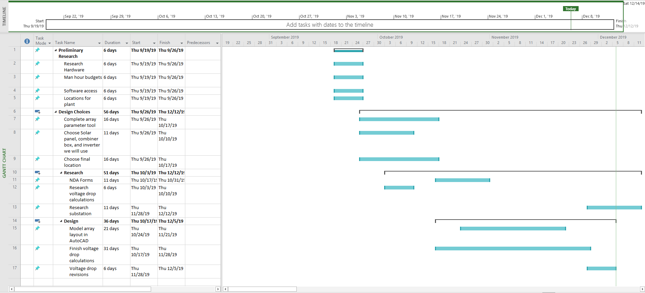
Project Schedule
Gantt Chart
Allowed our group to stay on schedule and complete tasks efficiently
sdmay20-14 | 10
Notes:
Jake

Slide 13
System Design
EE 491 | Fall 2019 | sdmay20-14
Functional Decomposition | Test Plan
Detailed Design | Prototype Implementations
HW/SW/Technology Platforms used
Notes:
jake

Slide 14
Functional Decomposition
Steps of project development
 | Activities
Stage-1 | Site identification.
Stage-2 | Feasibility study & risk evaluation.
Stage-3 | Conceptual plan & project outline.
Stage-4 | Sizing and calculation of associated components.
Stage-5 | Testing of our equipment.
Stage-6 | Solution
sdmay20-14 | 11
Notes:
Bashir

Slide 15
Technology Platforms
Array Parameter Tool
Black and Veatch provided excel sheet that contains relevant equations for sizing arrays.
Voltage Drop Calculator
Black and Veatch provided excel sheet that aids in calculating system voltage drop.
AutoCAD
Commercial computer-aided design and drafting software.
Used to make scaled drawings of solar plant layout.
sdmay20-14 | 12
Notes:
Michael

Slide 16
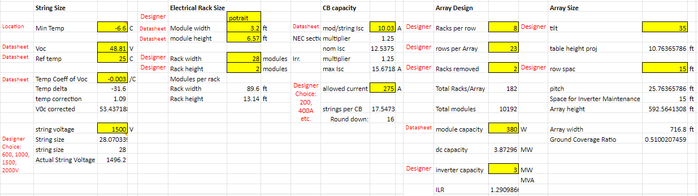
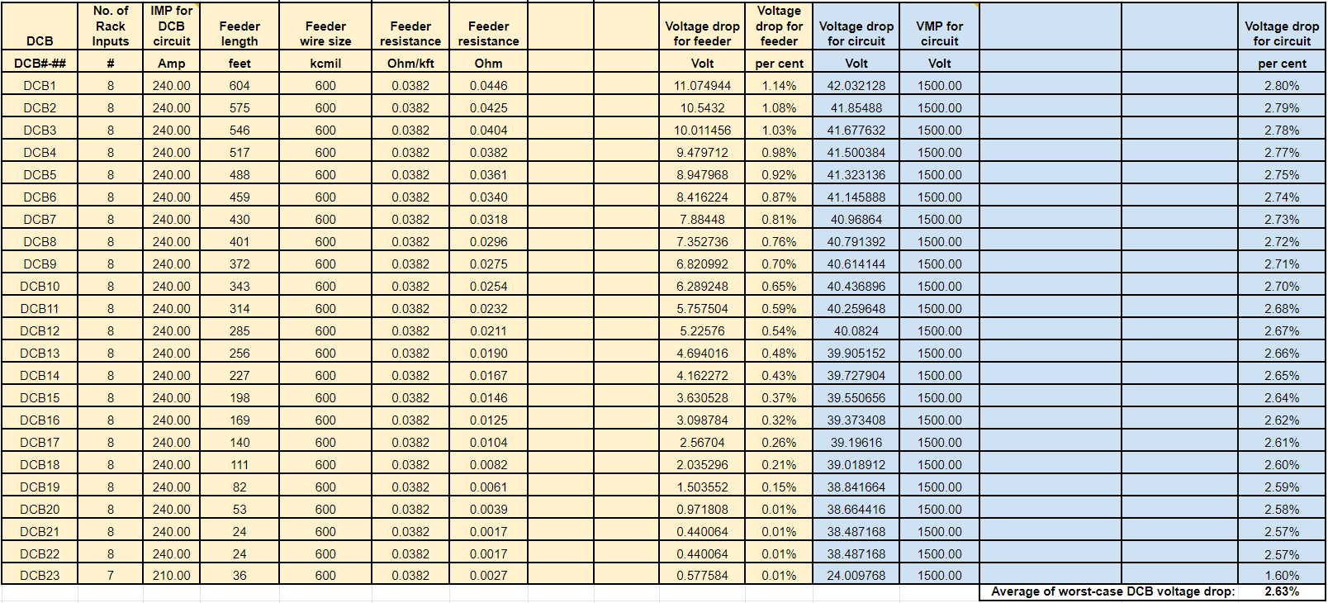
Technology Platforms
Array Parameter Tool
Voltage Drop Calculator
sdmay20-14 | 13
Notes:
Blake

Slide 17
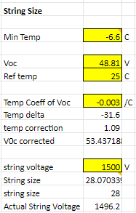
Detailed Design
Single Rack Layout
Each row is a string
Two strings wired in parallel make up a rack
String voltage - 1500 VDC
sdmay20-14 | 14
Notes:
Michael

Slide 18
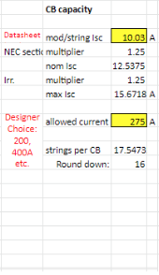
Detailed Design
Combiner Box Layout
Each combiner box connects 16 strings.
Combiner box is placed in the middle to reduce maximum conductor length.
Combiner box wires the racks in parallel.
sdmay20-14 | 15

Slide 19
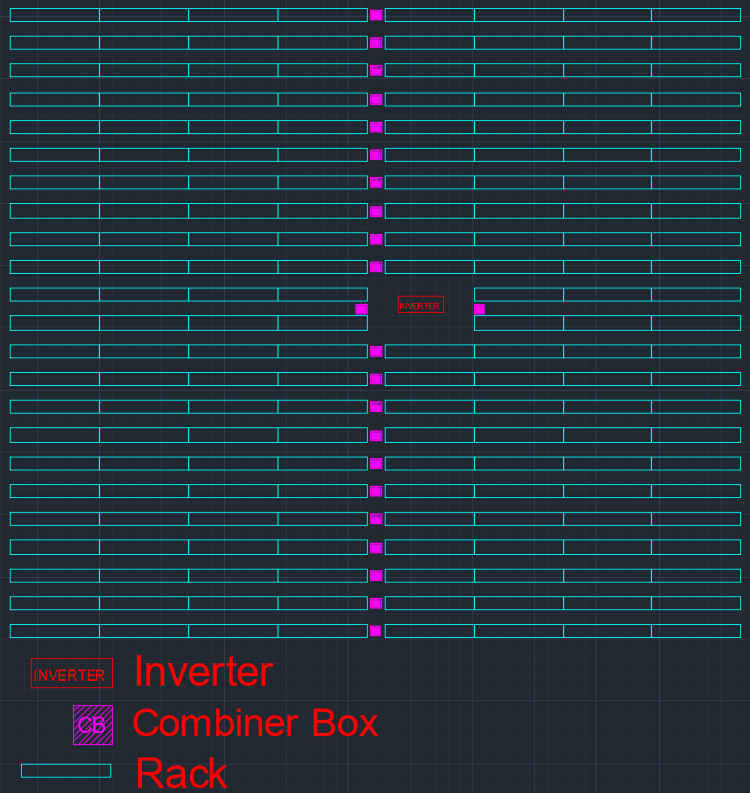
Detailed Design
Single Array Layout
Values per array
10,192 panels
182 racks
23 combiner boxes
2 racks removed
3.87296 MW
sdmay20-14 | 16
Notes:
Michael

Slide 20
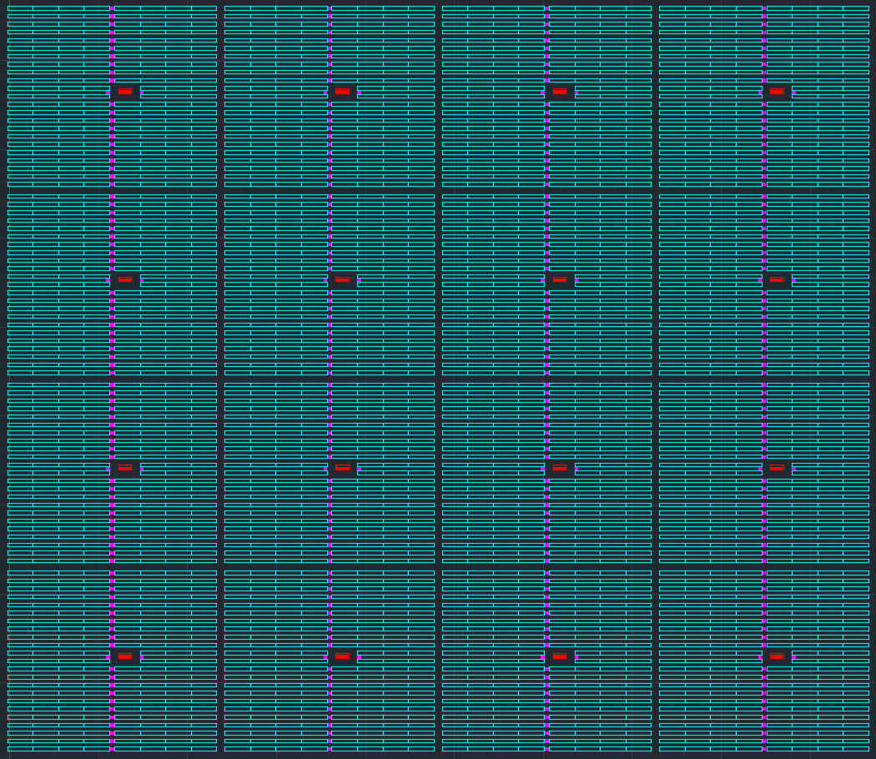
Detailed Design
Solar Plant Layout
16 arrays arranged in a 4x4 grid
There is a 30 ft wide access road between each array
Overall Dimensions
3,024 ft tall by 2,616 ft wide
163,072 total panels
368 combiner boxes
16 inverters
61.976 MW
sdmay20-14 | 17
Notes:
Michael

Slide 21
Test Plan
Design parameters & equipment
Comparison of solar panels
JA Solar vs Eagle 72
Shadow effect
Voltage drop losses
Location specifications
sdmay20-14 | 18
Notes:
Ethan

Slide 22
Implementations
Implementing the data from the datasheets into the array parameter tool and the voltage drop calculations.
Implementing the information found from the array parameter tools to the CAD drawing and the design modules
sdmay20-14 | 19
Notes:
Ada

Slide 23
Conclusion
EE 491 | Fall 2019 | sdmay20-14
Current Project Status | Plan for next semester
Task contributions of each project member
Notes:
Ada

Slide 24
Current Status
First semester accolades
Chose Plant location
Fully designed Solar Farm
Calculations of specific voltage drops
Ongoing Objectives
Researching substation designs and diagrams
Beginning preliminary substation work
sdmay20-14 | 20
Notes:
Ada

Slide 25
Team Members and Roles
Ethan Curnutte: Head Engineer
Blake Danek: Meeting Facilitator
Jake Ciccola: Reports Manager
Ada Lupa: Website Developer & Test Engineer
Michael Lortz: Design Engineer
Bashir Mohamed: Test Engineer
Roles are flexible and change frequently based on upcoming tasks
sdmay20-14 | 21
Notes:
ethan
image: https://www.sapanalytics.cloud/guided_playlists/role-management/

Slide 26
Individual Contributions
Ethan Created meeting agendas for client Ran meetings with client Led group and kept group organized Contributed to group work | Blake Main research for array design Finalized rack and array sizes Decided which solar panels would be used for the Plant Contributed to group work
Jake Created meeting agendas for client Recorded and sent meeting minutes Created detailed schedule and helped keep team on task Contributed to group work | Ada Uploaded documents and designed website Main research into site location Booked weekly meeting locations Contributed to group work
Michael Created CAD files Designed solar plant layout Contributed to group work | Bashir Participated in developing and planning the project. Contributed to group work voltage drop calculations & maximum power tracking.
sdmay20-14 | 22
Notes:
Team Slide

Slide 27
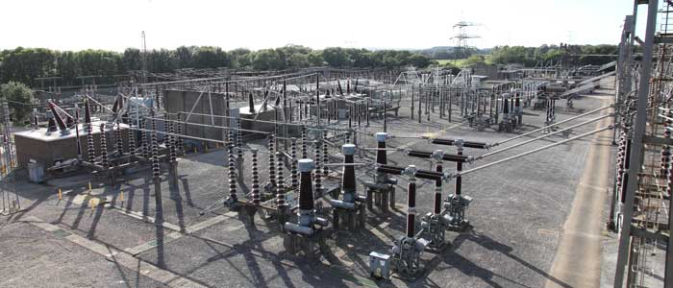
Plan For Next Semester
Update or change roles as needed
Add a role dedicated to checking emails to further ensure group is on task
Substation
Continue necessary research
Begin substation design
Complete Final Design
sdmay20-14 | 23
Notes:
Jake

Slide 28
Thank You!
EE 491 | Fall 2019 | sdmay20-14
Notes:
Team Slide

